Slide 1
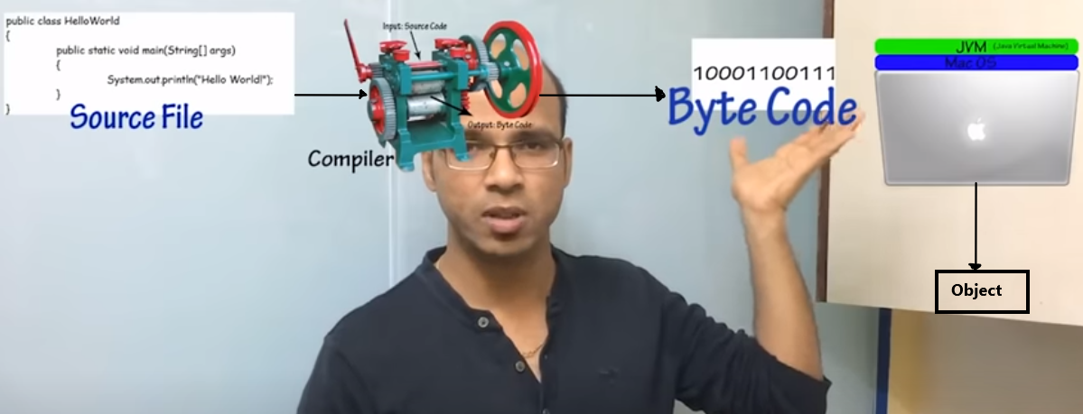
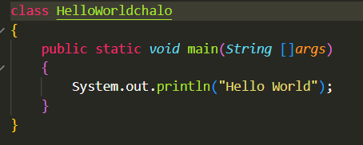
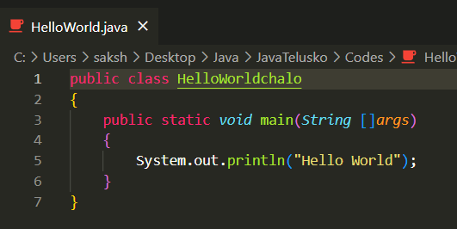
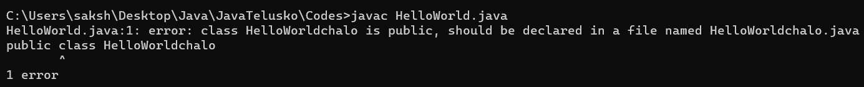
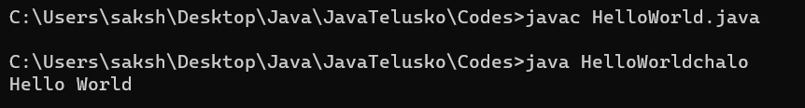

\
File name need not be same as the class name unless the class is public
The file .class contains the bytecode

Slide 2
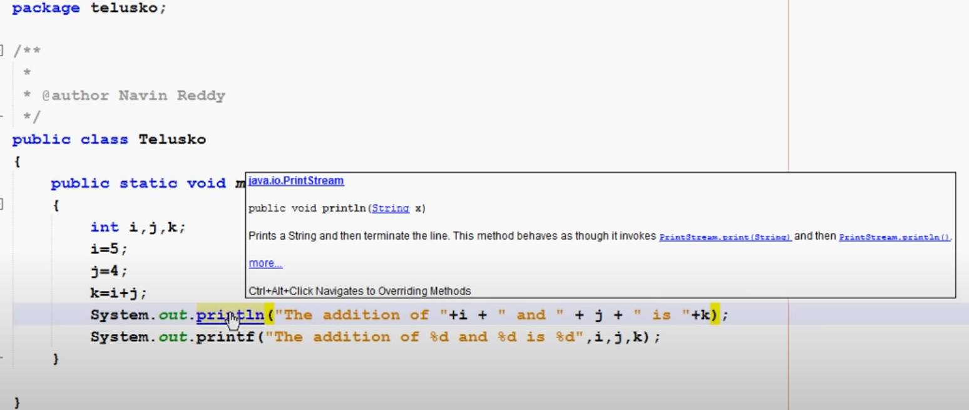
Printf usage

Slide 3
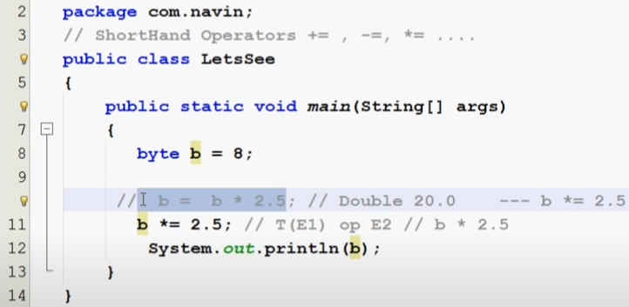

Typecasting and type conversion in java
* When you go for direct i.e.
B=B *2.5 then the type of whole things datatype is taken into account.
* But in this the datatype of the left side of the shorthand opera
Error
https://www.youtube.com/watch?v=JWFWbSH2Q_M&list=PLsyeobzWxl7oZ-fxDYkOToURHhMuWD1BK&index=18

Slide 4
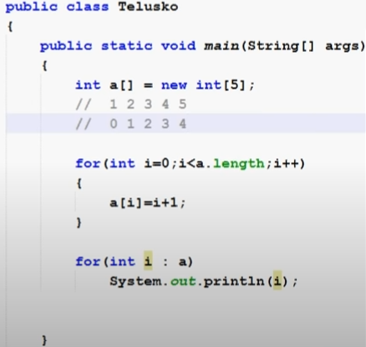
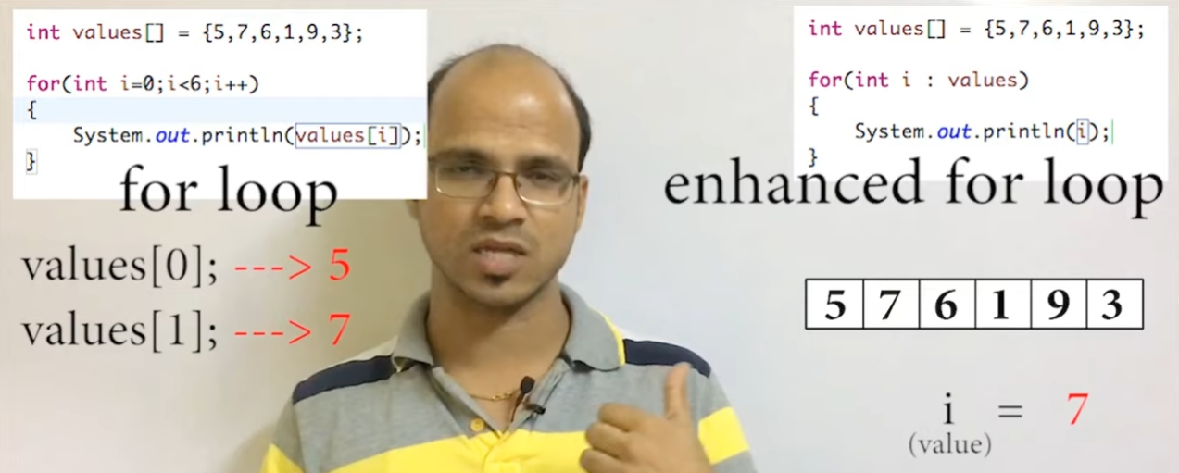
Enhanced for loops

Slide 5
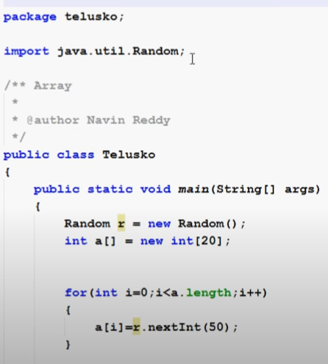
Random class in java

Slide 6
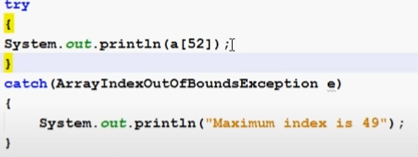
Java Exception Handling
https://www.javatpoint.com/exception-handling-in-java

Slide 7
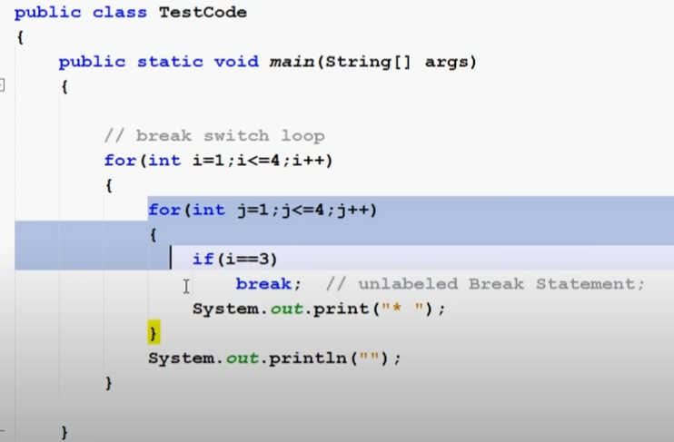
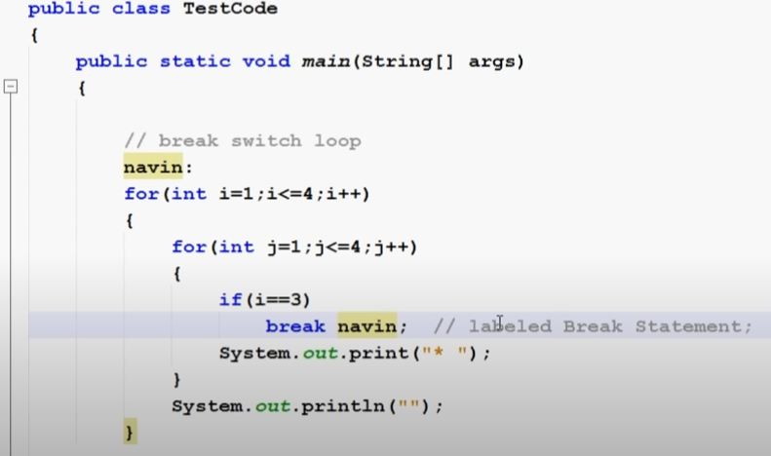
break statement
Not labeled break statement
Labeled break statement

Slide 8

DATA TYPES

Slide 9
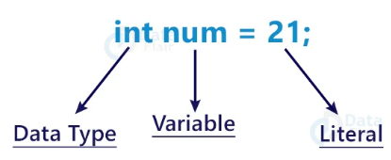

Slide 10
Read regarding ranges and value support from NOTES …..
Java is a type safe / strictly types → Means that whenever we use any variable we must make sure that the variable is declared first

Slide 11
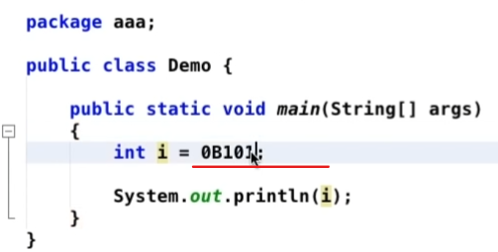

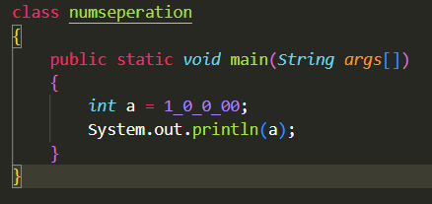
Plying with numbers
Binary Conversion
You can put that underscore after no matter how many zeros

Slide 12
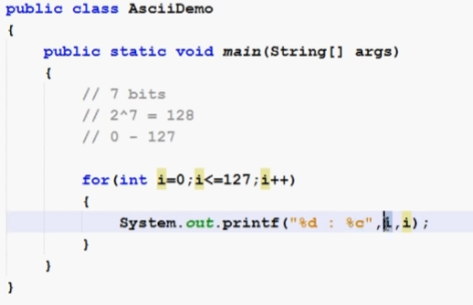
ASCII Codes

Slide 16
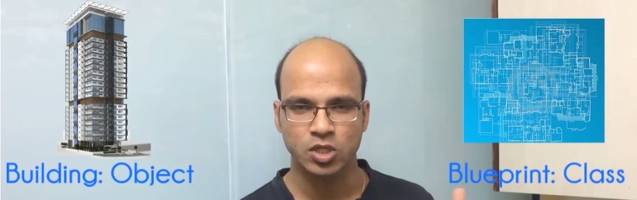
Classes and objects

Slide 17
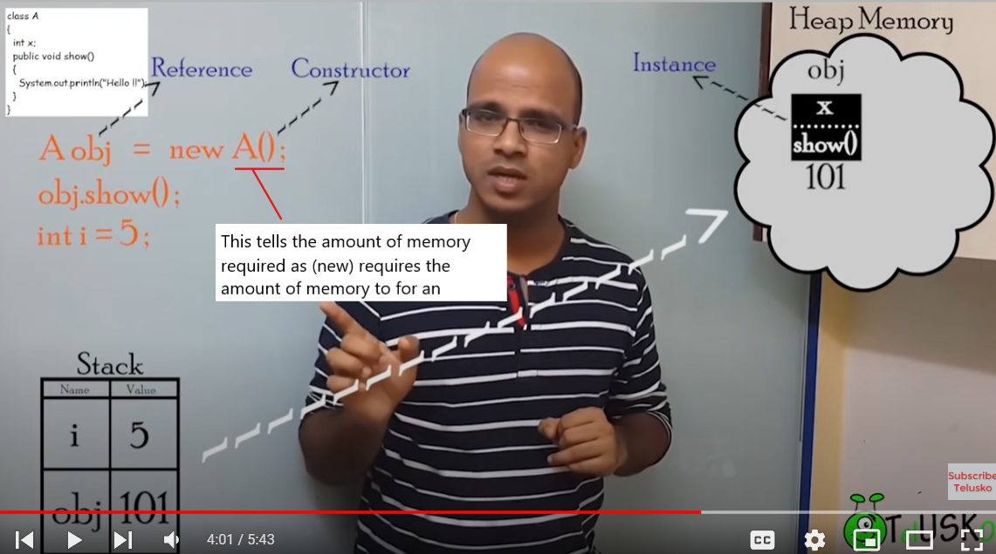

Slide 18
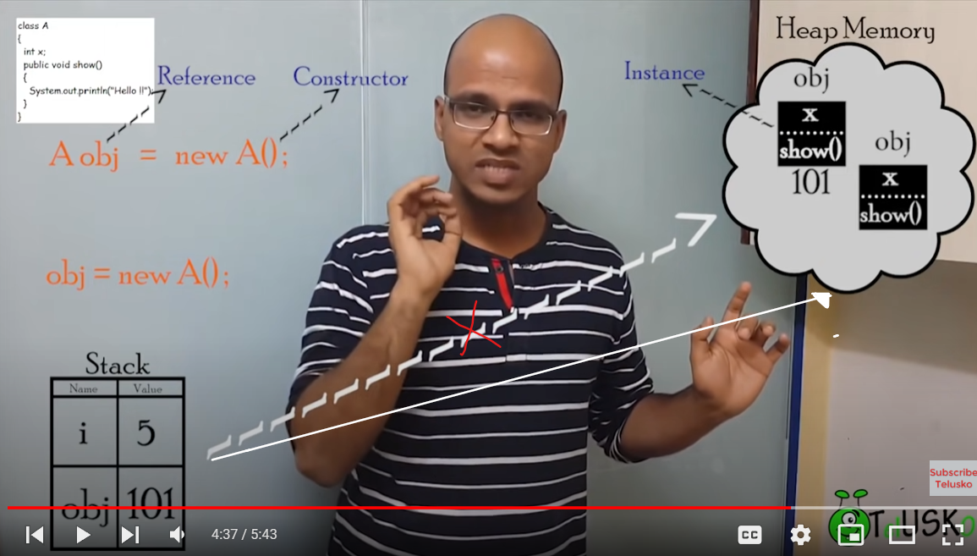

Deleting the link between object and refference
The above thing delinks the object and as soon as there is a delinking b/w the reference and obj the obj is deleted via GARBAGE COLLECTION .
Similarly for the second image when the link is deleted and the obj is deleted via GARBAGE COLLECTION .

Slide 19
Garbage collection

Slide 21
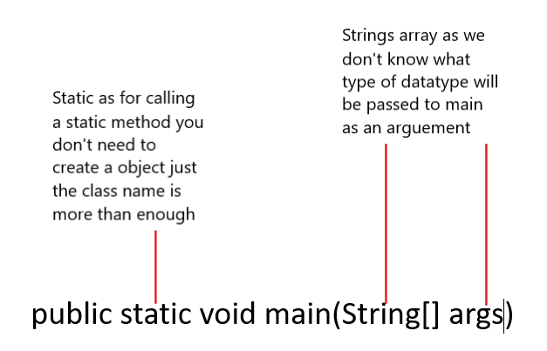
Main function

Slide 22
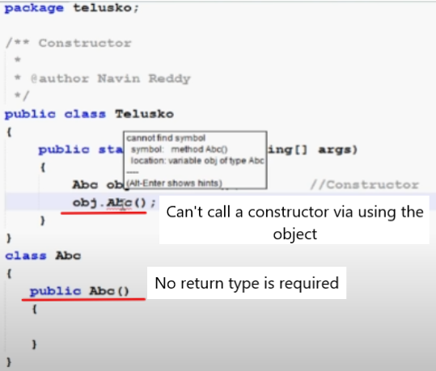
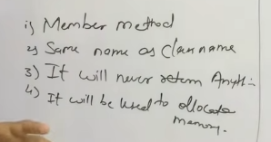
Constructors

Slide 23
There are five types of constructors in Java. They are:
No-argument constructors:
It’s like overriding the default constructor and used to do some pre-initialization stuff such as checking resources, network connections, logging, etc.
Default constructors:
This constructor is created when the class is written in Java and is used to initialize all the class's variables (attributes) to their default values (zero or null).
Parameterized constructors:
This constructor is used to initialize some variables from some values.
Final and Private constructors
What is a private constructor in Java?
Link : https://www.upgrad.com/blog/private-constructor-in-java/#:~:text=A%20private%20constructor%20in%20Java%20is%20used%20in%20restricting%20object,from%20outside%20the%20constructor%20class.
Private constructors can be used to create an immutable class.
Without using private constructors, we can create immutable classes by declaring the class final and creating all the attributes as final (e.g. private final String name;).
A private constructor cannot be directly called by client objects of the class. They can only be called internally by methods of the class (even private).
You can have a private constructor with one or more parameters.
You cannot have return type of the constructor be primitive boolean. It can be either String or Class.

Slide 24
Overloading and Overriding
Notes

Slide 25
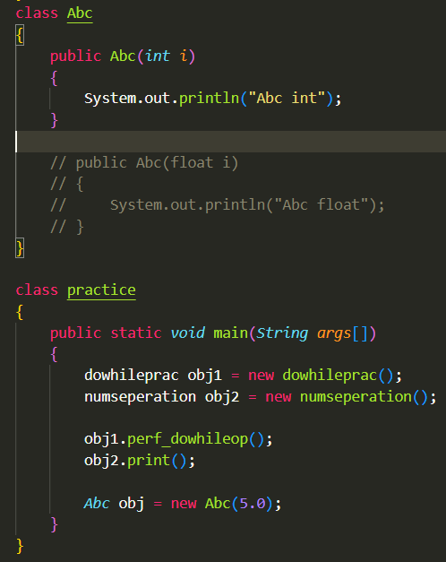
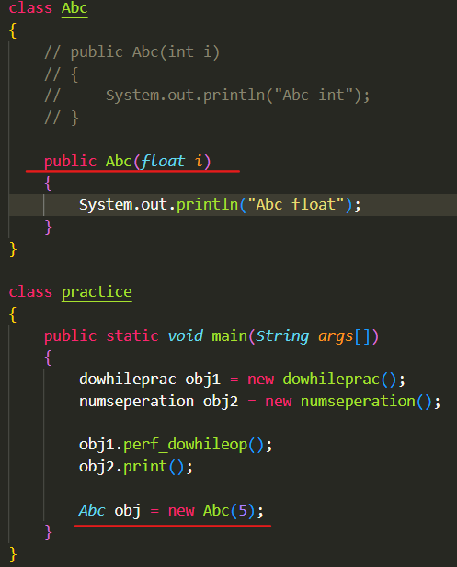
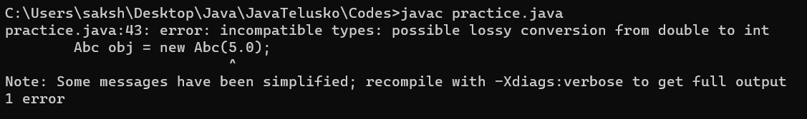
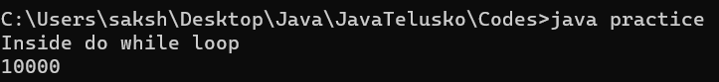
Constructor Overloading Implicit Conversion
Gives an error when here
Abc obj = newAbc(5.0) as 5.0 can’t be converted implicitly to integer

Slide 26
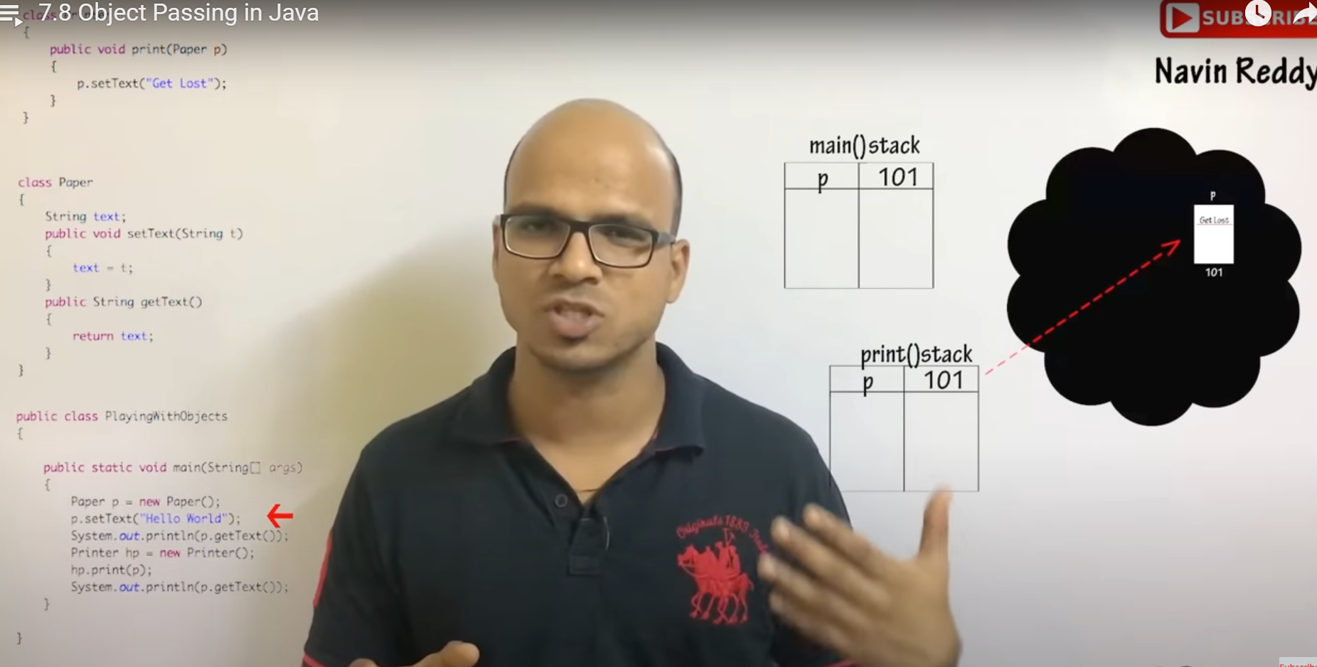
In java Everything is call by value
Even though we are doing call by value but what we are achieving here is call by reference as we have passed the hash code of the object

Slide 27

Packages
‘* com.Telusko.*’ will not fetch all the classes of test it will fetch all the classes of Telusko as Test is a folder and not a class inside the Telusko….

Slide 28
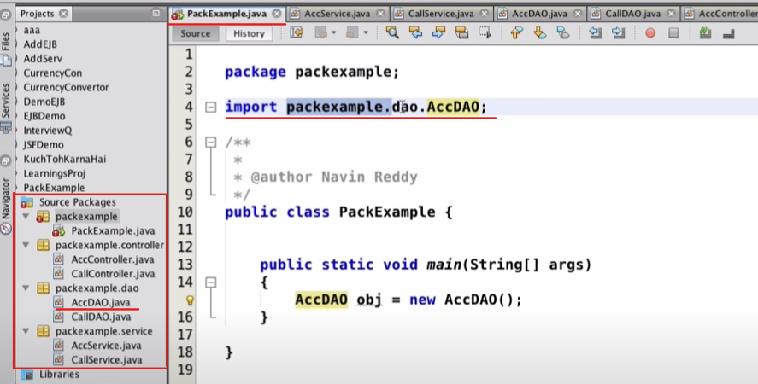

Slide 29
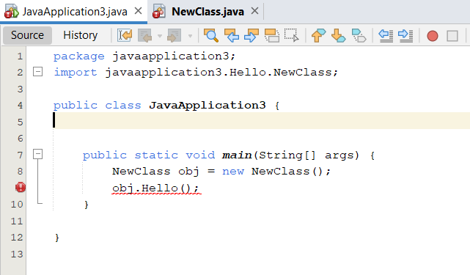
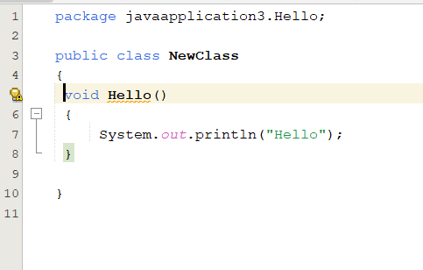
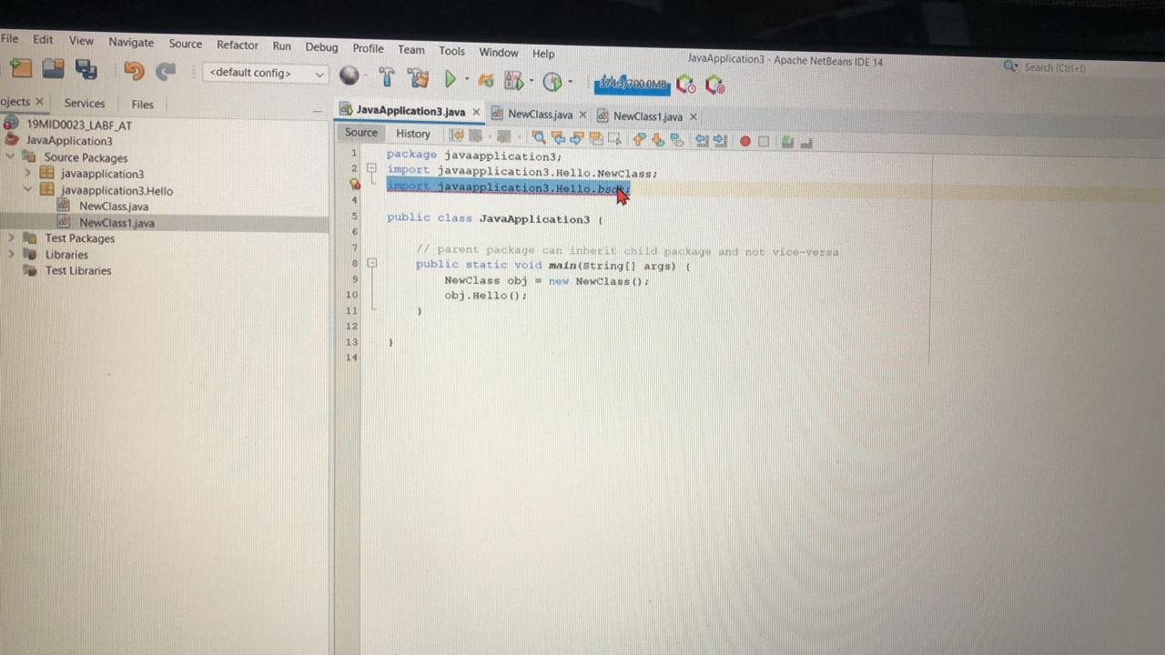
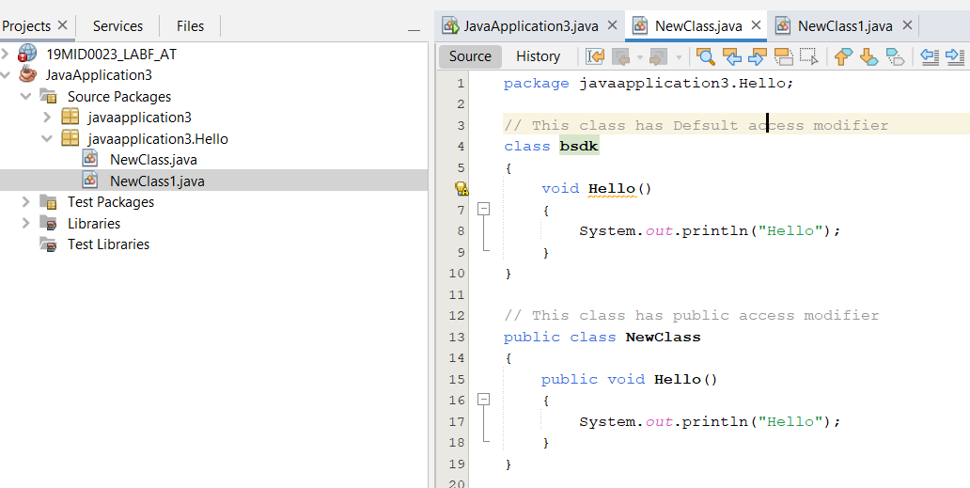
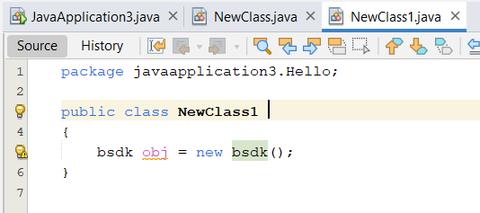
Error Here Default hence accessible only inside the package
Without Error
Here public hence accessible everywhere
// This causes errors
//import javaapplication3.Hello.bsdk;

Slide 30
parent package class accessible from child packge class in java?
https://stackoverflow.com/questions/3564663/parent-package-class-accessible-from-child-packge-class-in-java

Slide 31

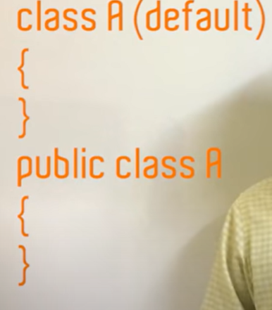
Access Modifiers
Private: The access level of a private modifier is only within the class. It cannot be accessed from outside the class.
Default: The access level of a default modifier is only within the package. It cannot be accessed from outside the package. If you do not specify any access level, it will be the default.
Protected: The access level of a protected modifier is within the package and outside the package through child class. If you do not make the child class, it cannot be accessed from outside the package.
Public: The access level of a public modifier is everywhere. It can be accessed from within the class, outside the class, within the package and outside the package.

Slide 32
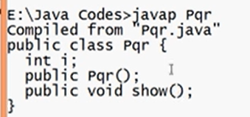
javap BYTEFILENAME
It gives the supposedly structure

Slide 33
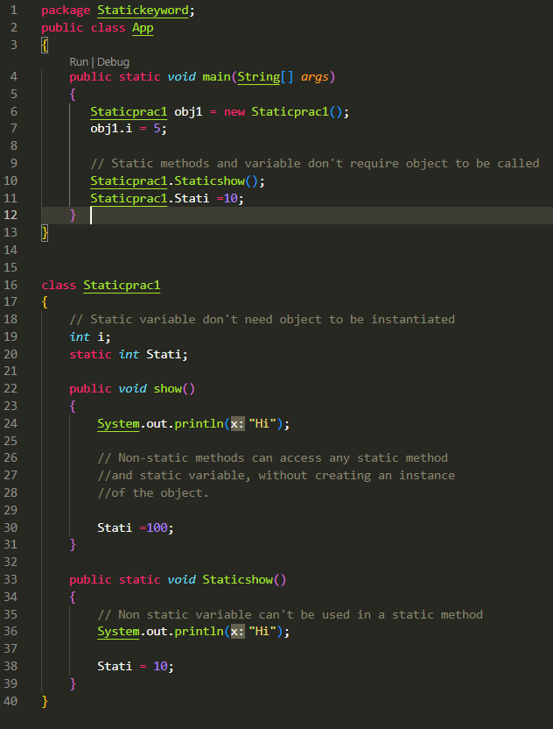
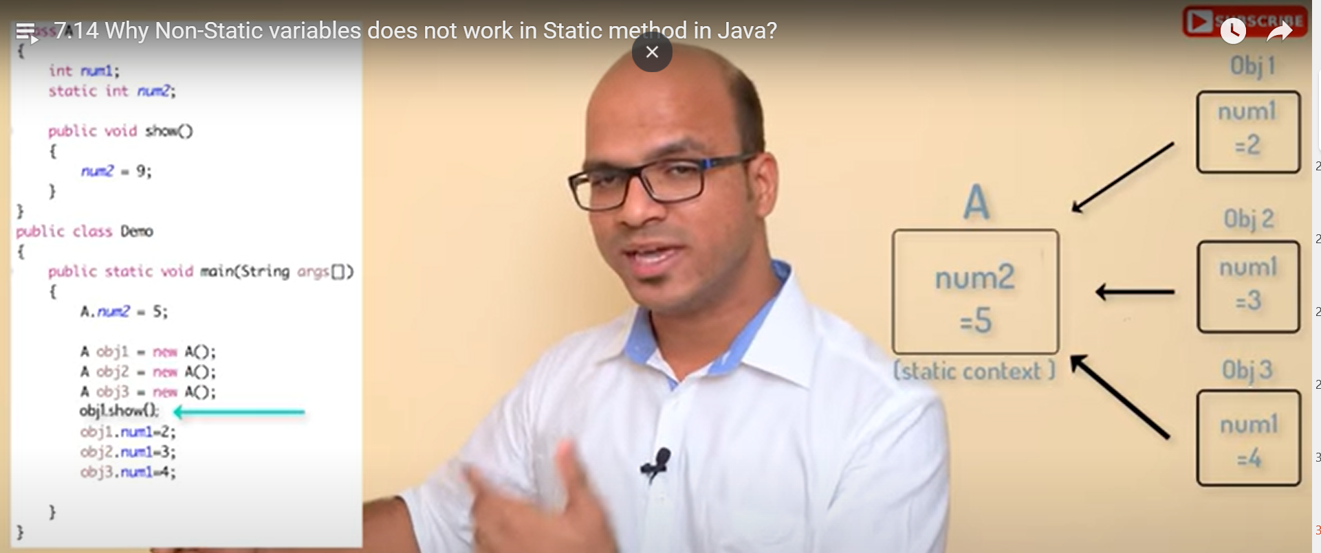
Static
Static Keyword
* Static variables are shared via different objects.
* Hence Assign things which has to be common amongst all the instance objects as Static
We can use a Static variable inside a non- static method but the re- verse is not true.

Slide 34
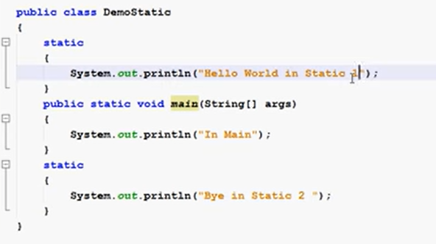
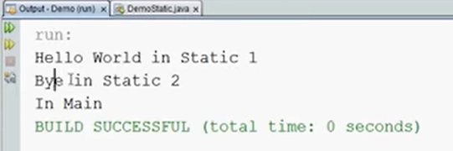
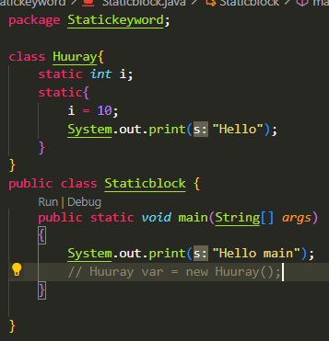
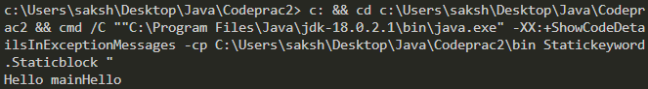
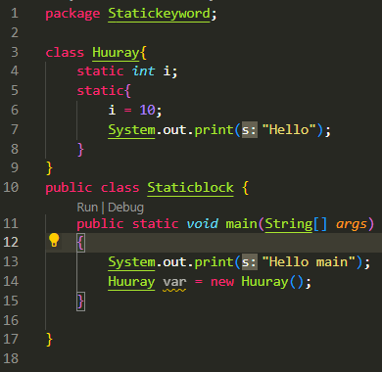
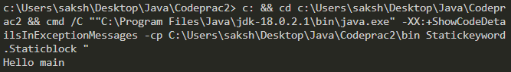


Static Block
It’s a block which is executed when ur class is loaded in memory
code inside the static block is executed only once: the first time the class is loaded into memory.
Before even going to main method
It’s important to have the class loaded in the memory hence initialisation of class object is very important
* Static block is executed before static

Slide 35
7.16

Slide 36
7.17

Slide 37
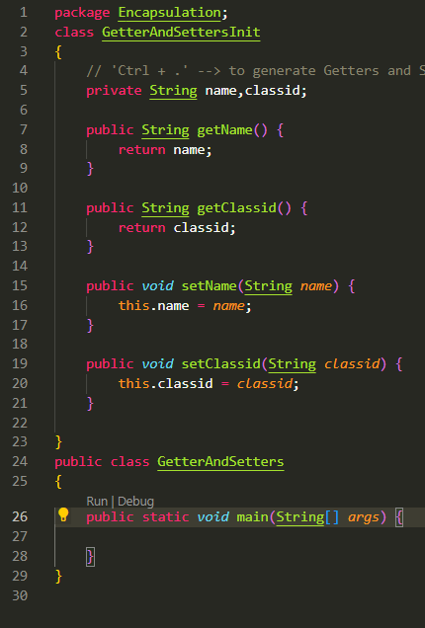
Encapsualtion
Class variables values shouldn’t be directly changed .It must be accessed/ changed via used of getters / setters

Slide 38
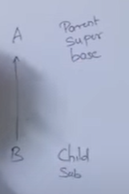
Inheritance
Single
Multilevel
Multiple → Not supported

Slide 39
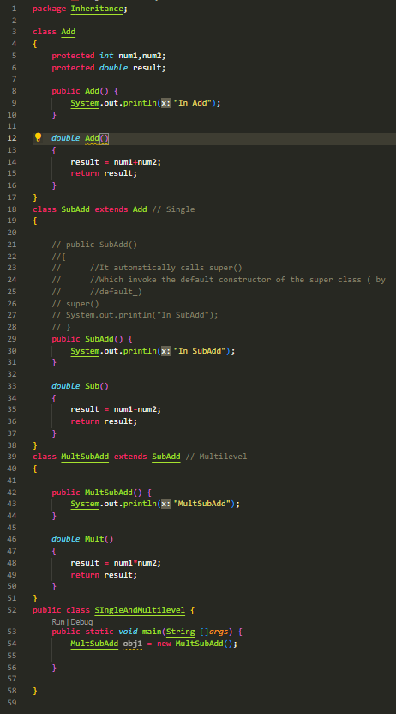

Slide 40
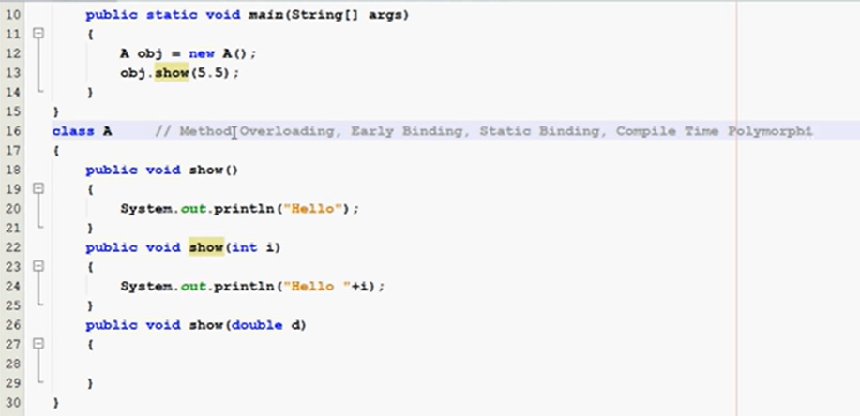
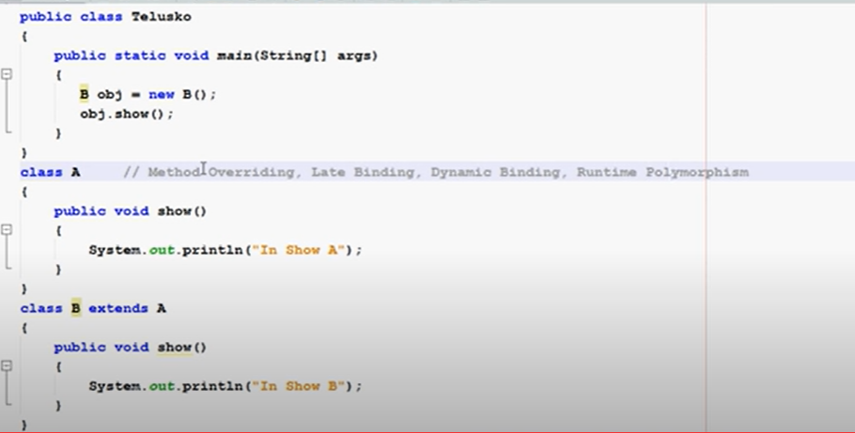
Polymorphism
Overloading → same method name but different types of parameters/Number of variables
Overriding → Child class overrides parents class methods

Slide 41
Overidding Method Dispatch in Java

Slide 42
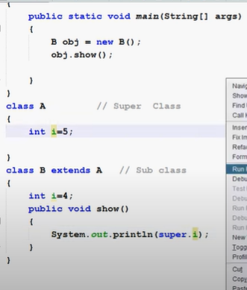
Super Keyword

Slide 43

Final

Slide 44

This keyword

Slide 45

AnonymousObject

Slide 46

Abstract class
Abstract class don’t require any method

Slide 47

Concrete classes and abstract classes
In this Mahesh and Ramesh are abstract classes as
Ramesh is not able to define microwave function which he got from Mahesh but Suresh is a concreate class as till him all the functions are defined

Slide 48


Interface
Multilevel inheritance in Interfaces
Multiple inheritance

Slide 50
toString()

Slide 51

Compile time →Syntactical errors
Runtime error → Exception
Logical Error → Problem with the logic

Slide 52


.equals()

Slide 53


Slide 54
Doubts
https://www.youtube.com/watch?v=a-HaDCGJw0o&list=PLRX9Q8jR15s1ygC_apa-iTftCqrcdPIkF&index=1
Class and methods and attributes have different access modifiers
Can a Constructor has access modifier other than public in java
Private class
Final class and methods
A class which has no no-argument constructor MUST be declared as final
flow of execution in java
Declare and initialize object outside of method?

Slide 55


